Slide 1
Quick Refreshers on Graph Theory
By bipin sinha

Slide 2
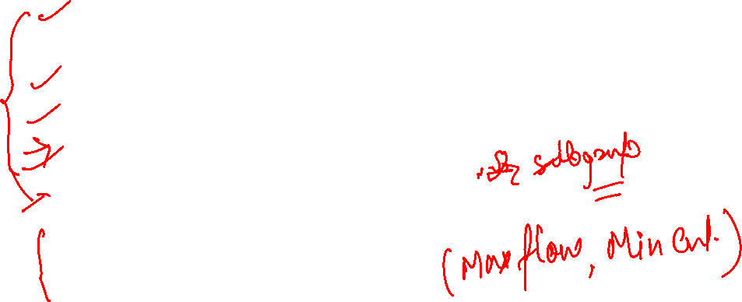
Agenda
HandShaking Theorem
Havel Hakimi Theorem For Degree Sequence of a Graph
Complement of a Graph in Graph Theory Discrete Mathematics
Euler Graph/Hamiltonian Graphs
Isomorphism in Graph Theory
Planer / Non-Planer Graph
Edge CutSet/Vertex CutSet

Slide 3
What is Graph Theory
Graph theory is a theoretical tool in the branch of discrete mathematics which deals with graph data structure and solves various problem related to graphs. Its interdisciplinary topic ranging from Network , biology, chemistry, finance , electrical engineering, mechanical engineering, physics, medical sciences, transportation, databases, electronic circuit etc.
We can convert the given problem in graph structure then by using graph theory as tool we can solve many problem by applying graph theory theorems and properties.

Slide 4


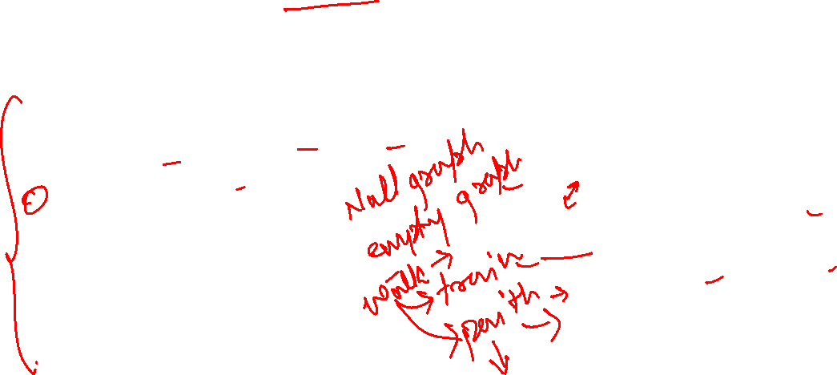
Recap Graph Data Structure Terminologies
In graph data structure following topics covered:
Graph data structure, Directed graph, undirected graph
Nodes/Vertices/Endpoints, Adjacent vertices, Pendent vertices, isolated vertices
Edges, Adjacent edges, Self-loop, Parallel edges
Directed graph, undirected graph
Degree of a vertex
Path, Simple path ,Cycle, simple cycle
Subgraph , Spanning Subgraph
Connected and Non Connected Graph
Adjacency Matrix, Adjacency List, Edge List
Breadth First Search (BFS), Depth First Search (DFS)
Graph Type | Self Loop | Parallel Edges
Graph
Multi-Graph
Pseudo-Graph
Simple-Graph

Slide 5
what is difference between walk and random walk in graph
In graph theory, a "walk" refers to a sequence of vertices and edges that connect them in a graph. A walk can traverse through the graph by moving from one vertex to an adjacent vertex along an edge.
A "random walk" is a specific type of walk in which the next step or vertex to visit is chosen randomly from the set of adjacent vertices of the current vertex. In other words, at each step of the random walk, the walker randomly selects one of the neighboring vertices to move to. This process continues for a certain number of steps or until a stopping criterion is met.
One key aspect of random walks is their stochastic nature, meaning that the outcome of each step is determined by chance. Random walks are often used in various fields such as physics, computer science, and finance for modeling processes like diffusion, web crawling, and stock price movements, among others. They have interesting properties and can be used to analyze the structure and behavior of graphs in various contexts.

Slide 6
can edges and vertices be duplicate in random walk
In a typical random walk on a graph, the process involves moving from one vertex to another along an edge. In this context, edges and vertices can't be duplicated in the sense that once a vertex has been visited, it's typically not revisited in the same random walk. However, depending on the specific application or formulation of the random walk, there might be variations.
For instance, in some cases, a random walk can revisit vertices and edges. These are often referred to as "self-avoiding random walks" or "non-backtracking random walks". In such walks, the walker avoids revisiting vertices or edges it has already traversed. This variation is common in applications like polymer modeling or analyzing the behavior of certain types of networks.
So, in summary, whether edges and vertices can be duplicated in a random walk depends on the specific context and formulation of the random walk being used.

Slide 7
Can edges and vertices be duplicated in walk?
Yes, in a walk on a graph, both edges and vertices can be duplicated. A walk is simply a sequence of vertices and edges that connects them, and it can include repetitions of both vertices and edges.
In a walk, you can move from one vertex to another via an edge, and you can revisit vertices and edges multiple times. There are no restrictions on whether vertices or edges can be duplicated in a walk.
For example, consider a simple walk on a graph with vertices A, B, C, and edges connecting A to B, B to C, and C back to A. A walk from A to C could be: A -> B -> C -> A -> B -> C, where both vertices and edges are repeated.

Slide 8
Important Definition
Note: Edge depends upon vertex but vertex do not depend on edges.
Graph is modelled as G(V,E) where V is set of vertices and Edge is set of edges
Infinite Graph are those graph where V and E set is infinite.
Finite Graph are those graph which has finite set of vertices and edges.
Null Graph are those graphs where edge set is empty
Trivial Graph are those graph where edge set is empty and vertices set has only one value.
Complete Graph are those simple graph where all vertices and connected with all other vertices.
Note: Edge depends upon vertex but vertex do not depend on edges.

Slide 9
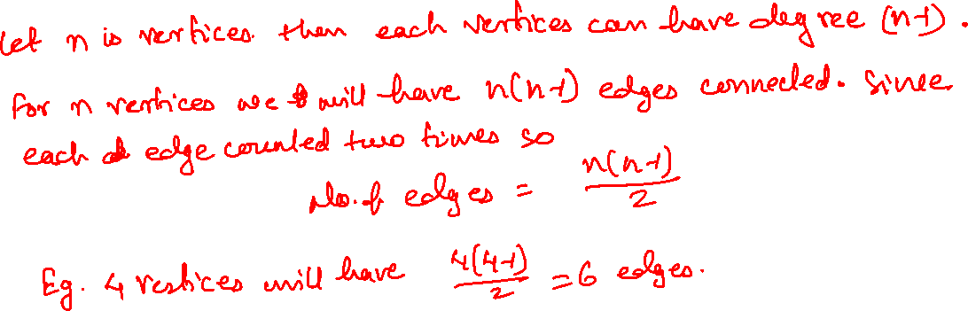
How to find number of edges in complete graph

Slide 10
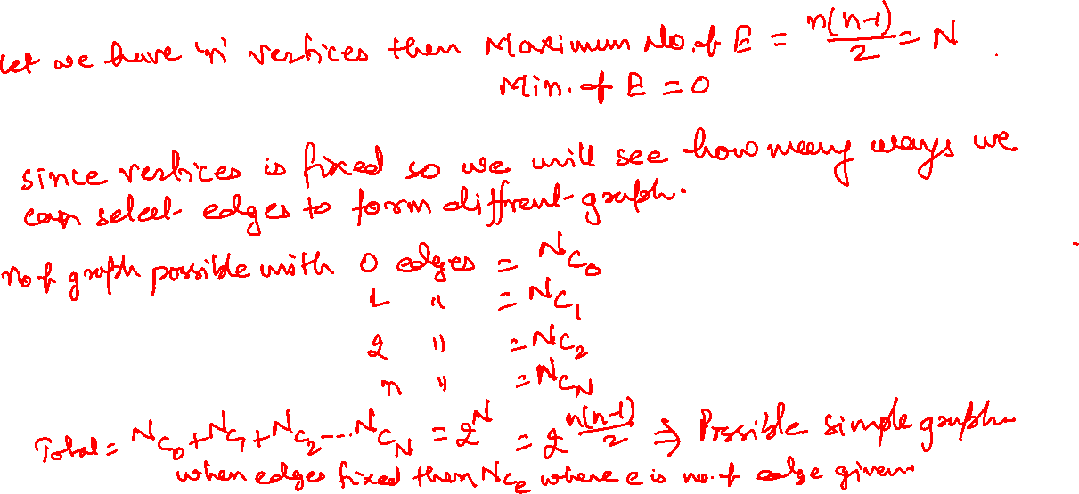
How to find number of simple graph based given vertices

Slide 11
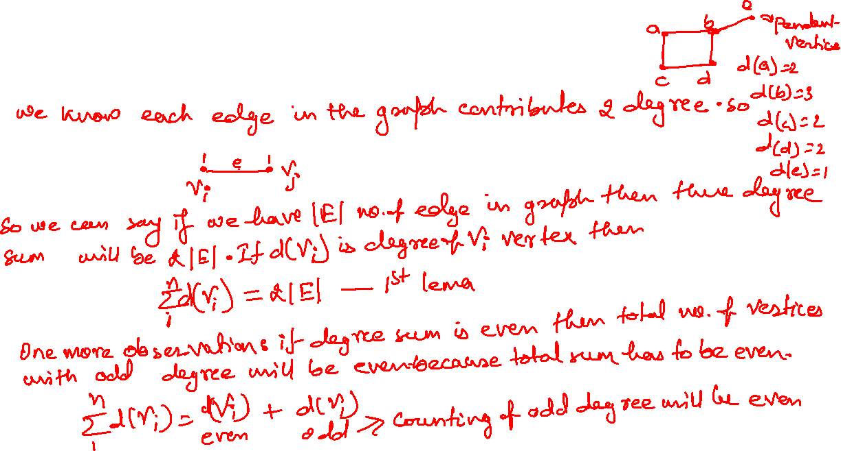
Handshaking/ Degree sum theorem

Slide 12
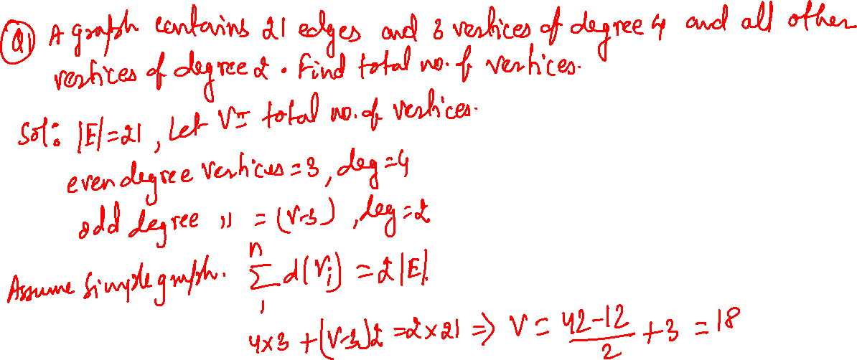
Practice Question(Handshaking lema)

Slide 13
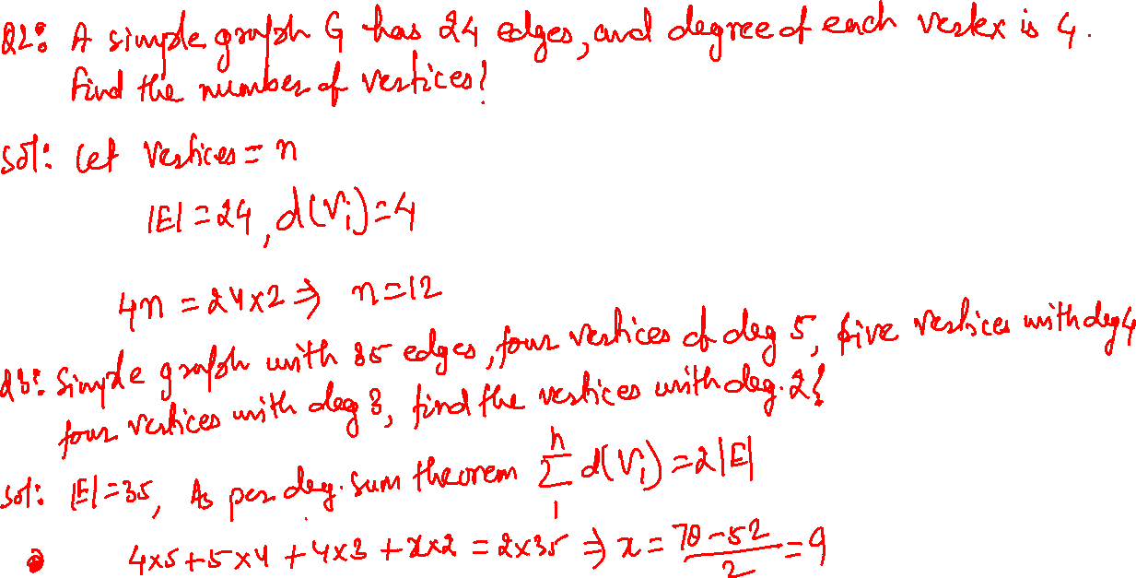

Slide 14
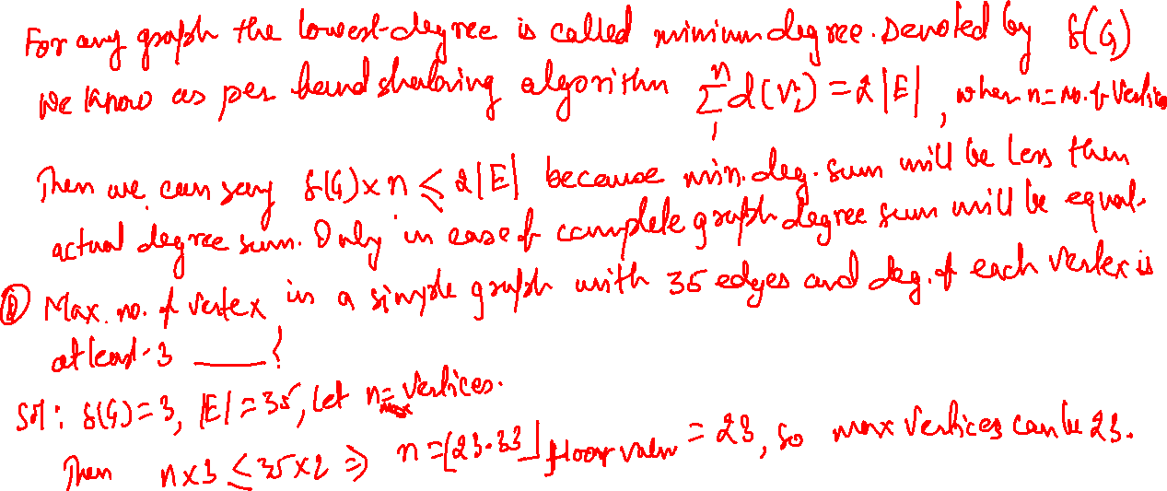
Minimum Degree Inequality relation

Slide 15
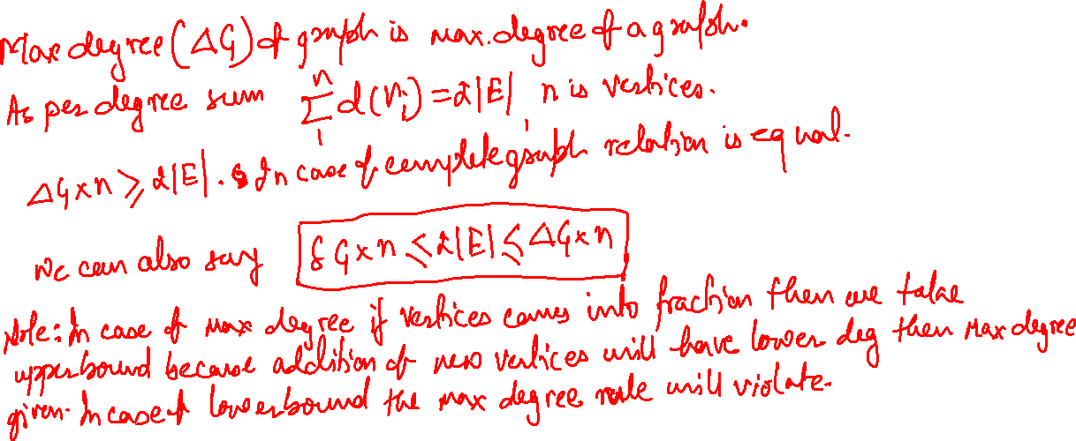
Max Degree Inequality relation

Slide 16
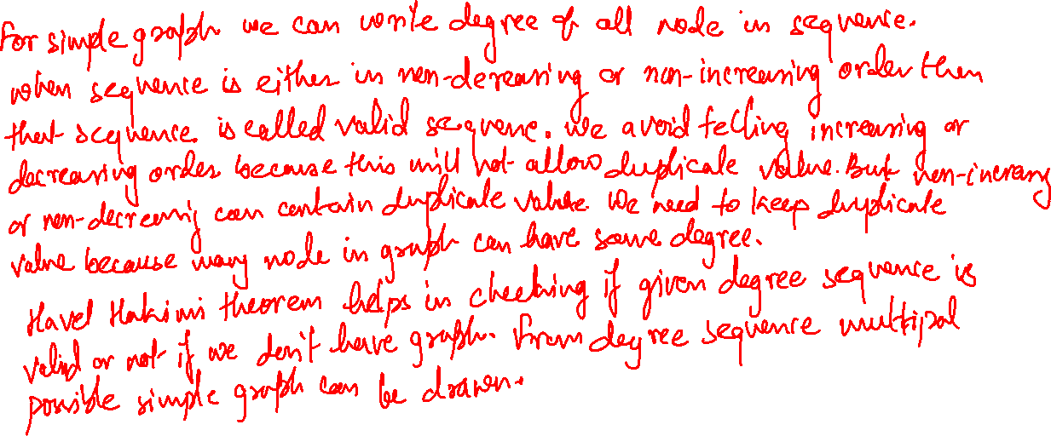
Degree Sequence and Havel Hakimi Theorem

Slide 17
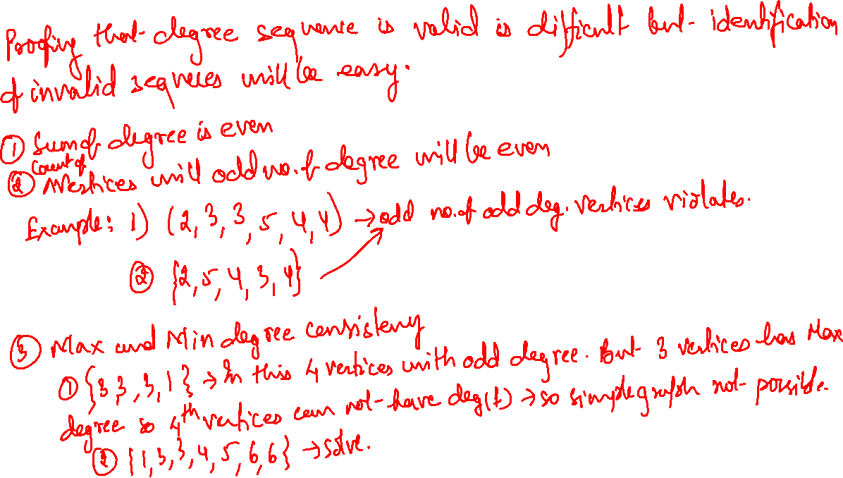
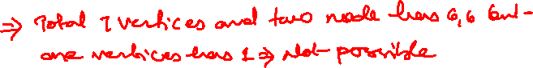

Slide 18
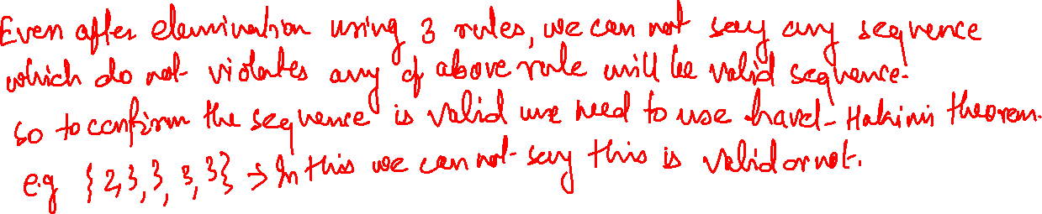

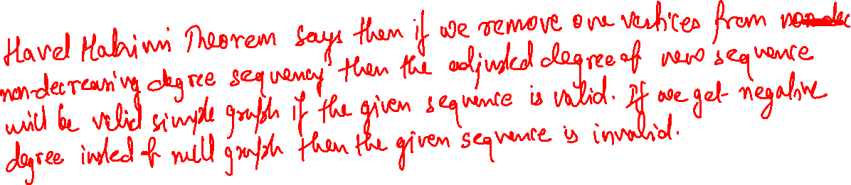
Havel Hakimi Thorem

Slide 19
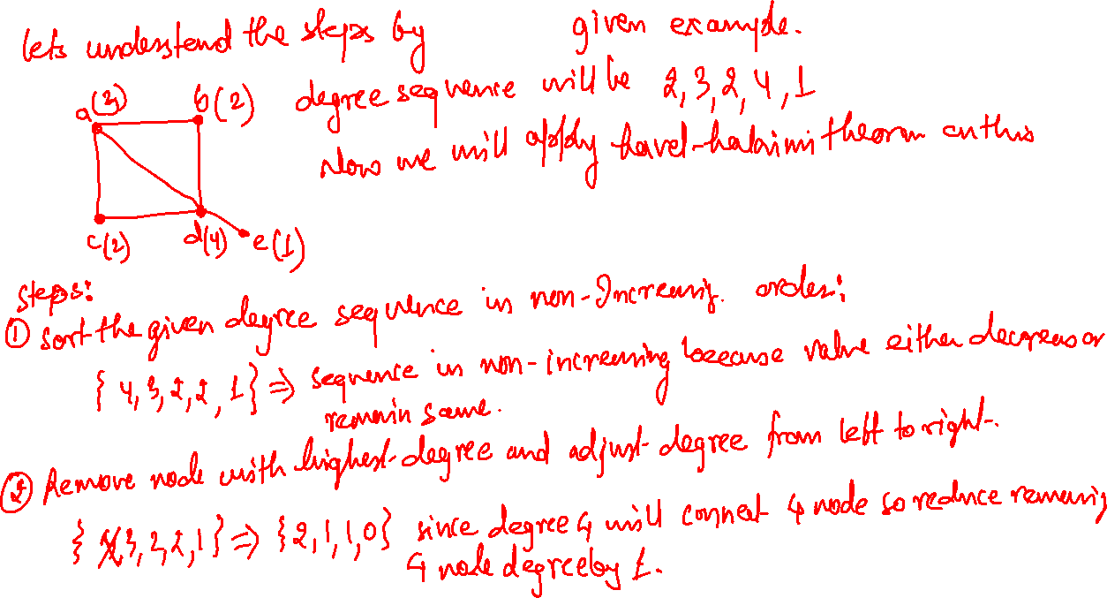

Slide 20
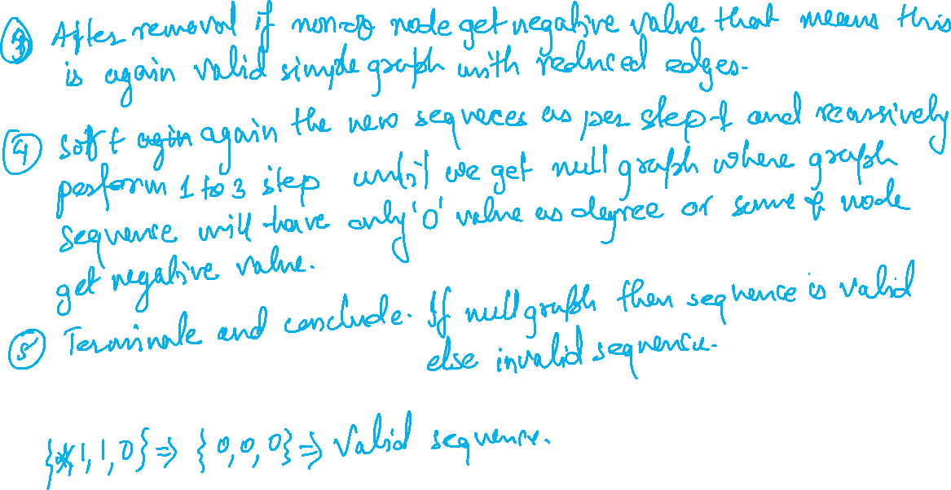

Slide 21
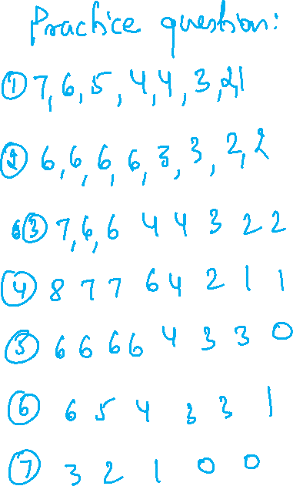

Slide 22
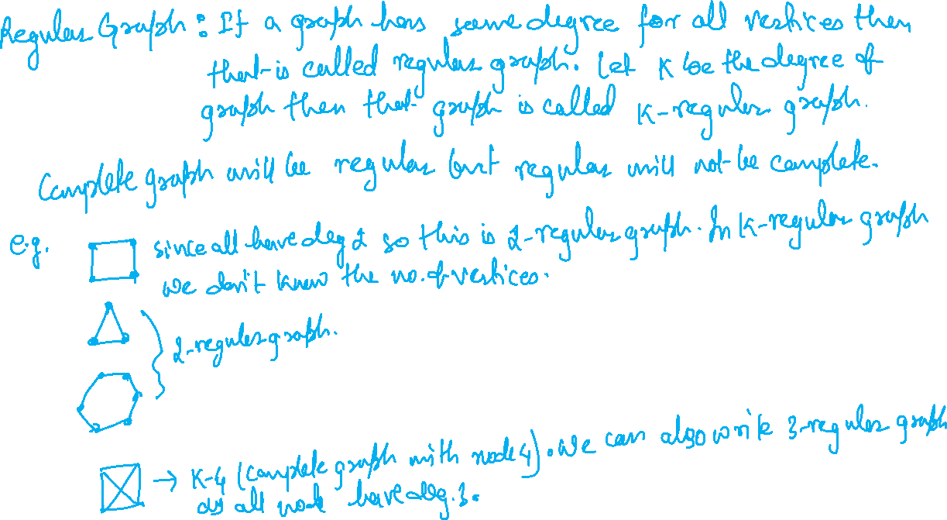

Slide 23
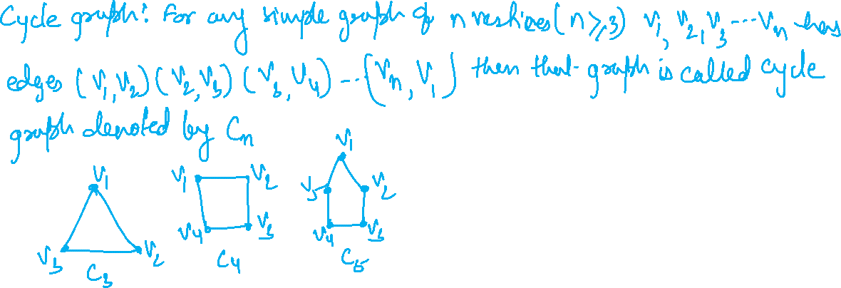
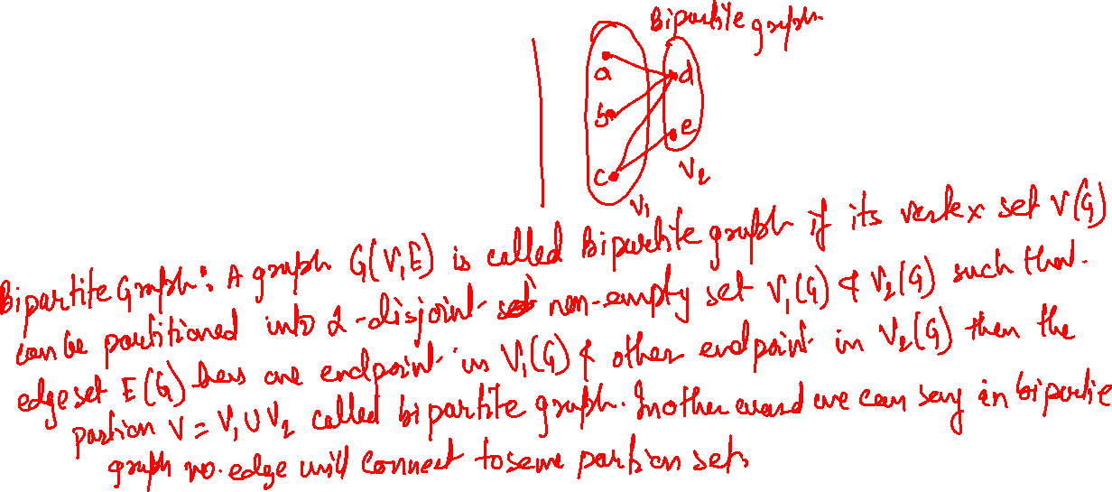

Slide 24
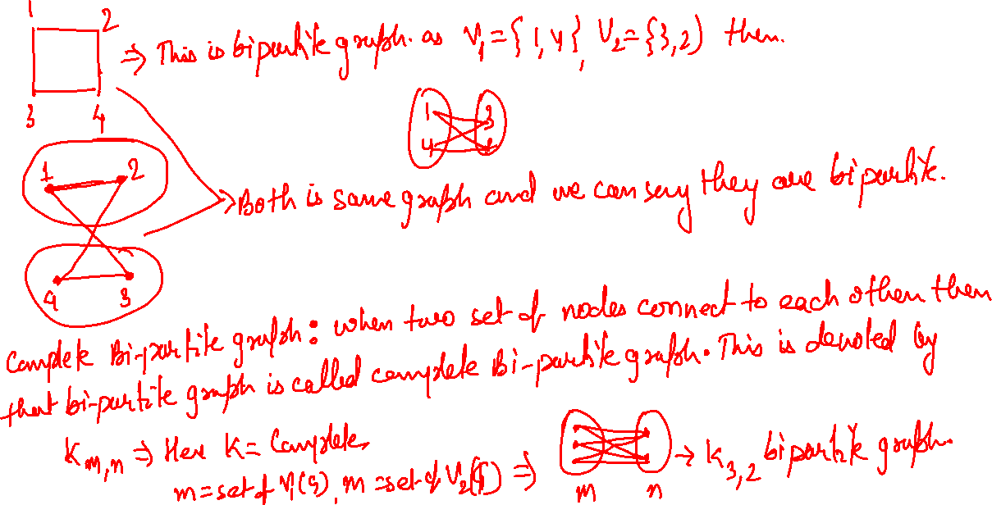

Slide 25
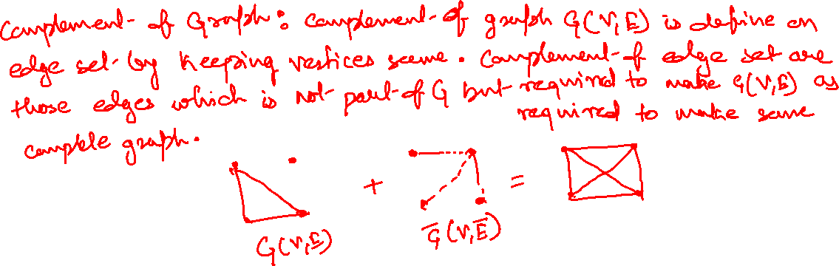
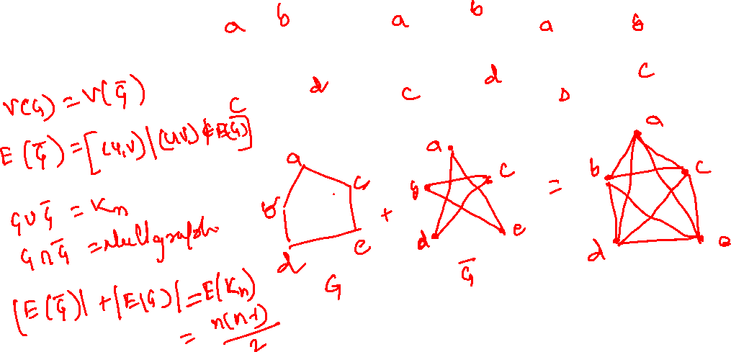

Slide 26
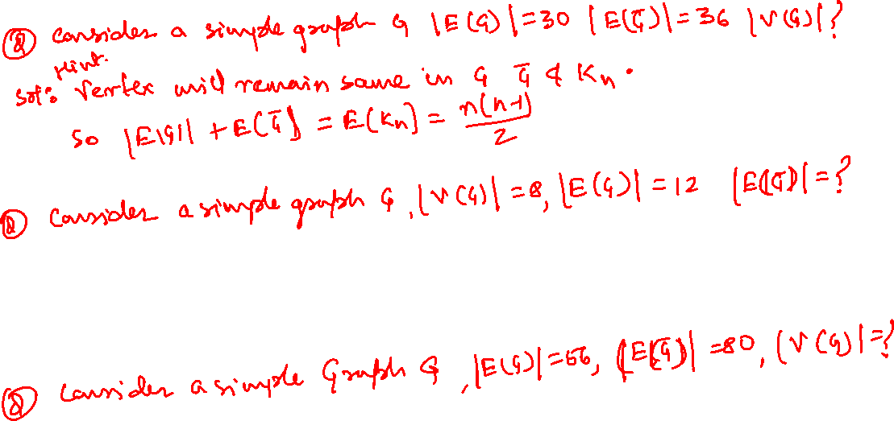
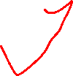

Slide 27

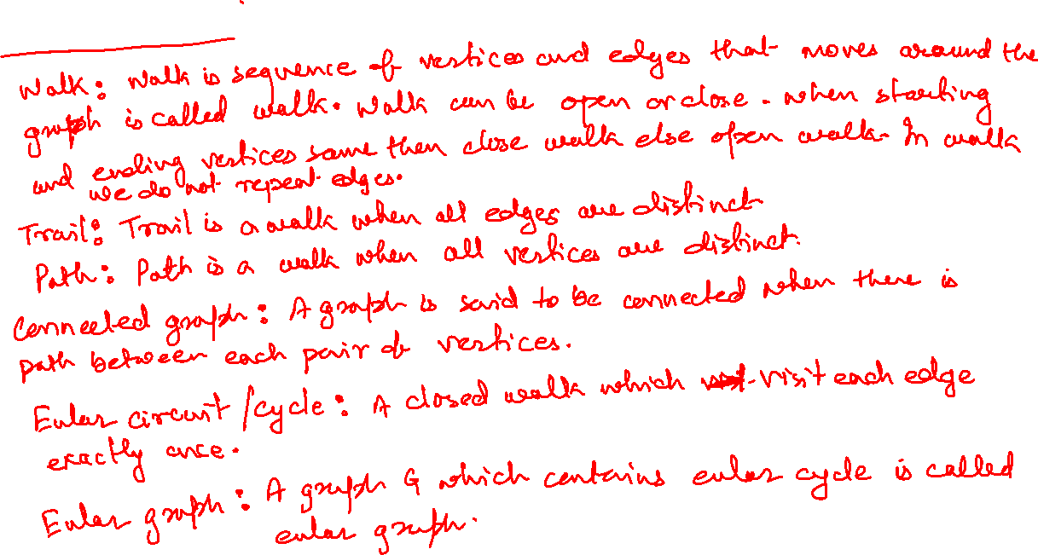

Slide 28
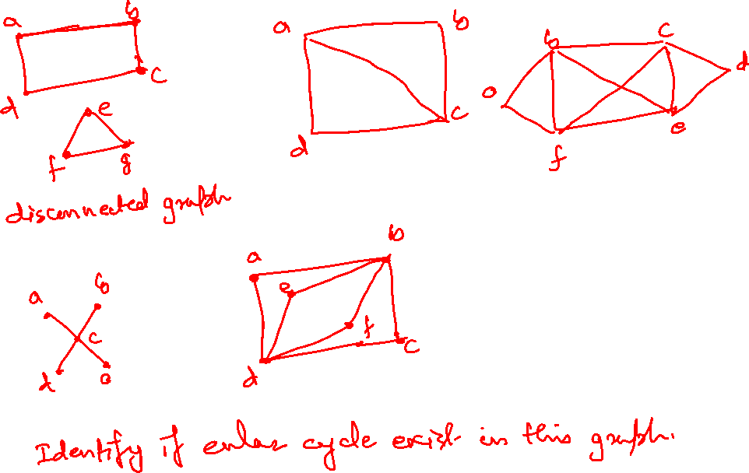

Slide 29
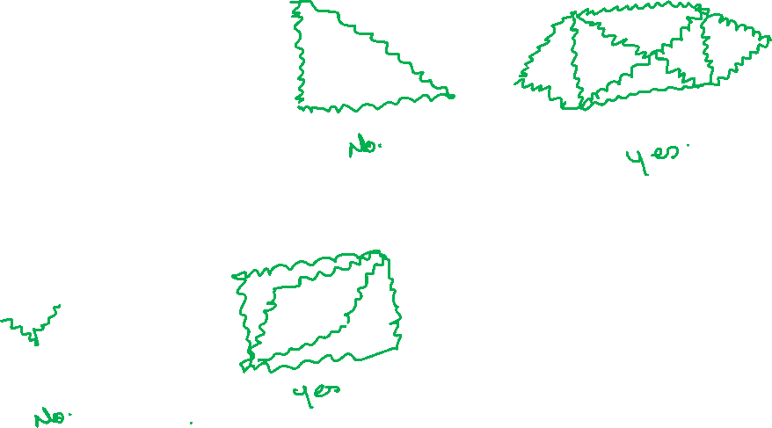

Slide 30
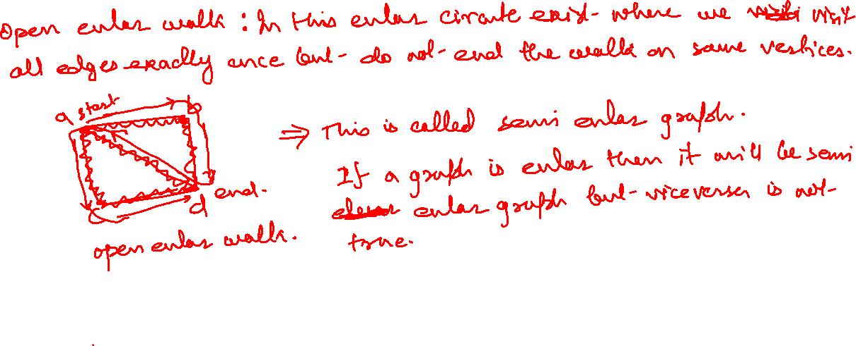

Slide 31
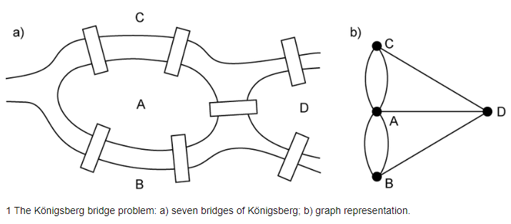
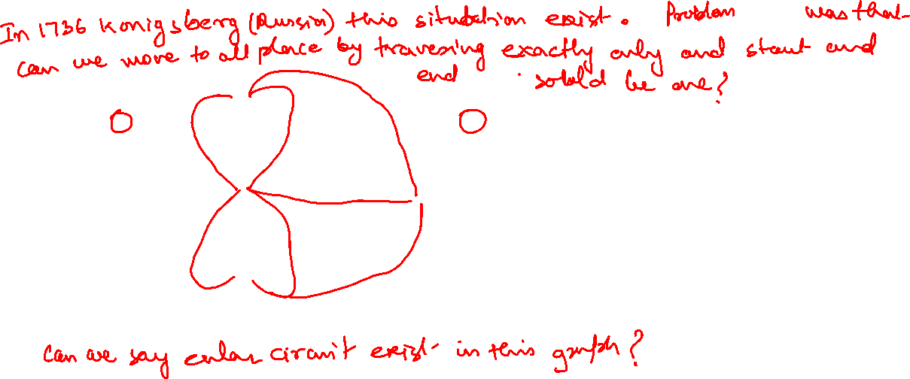
Seven Bridges of Konigsberg Problem

Slide 32
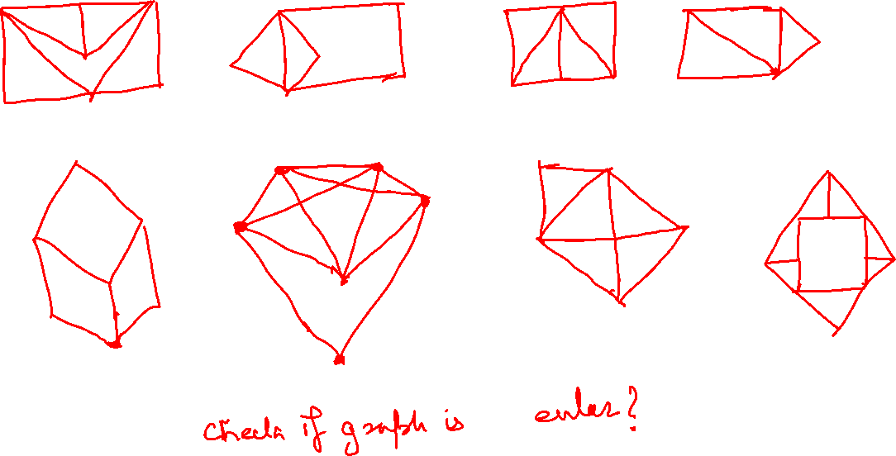

Slide 33
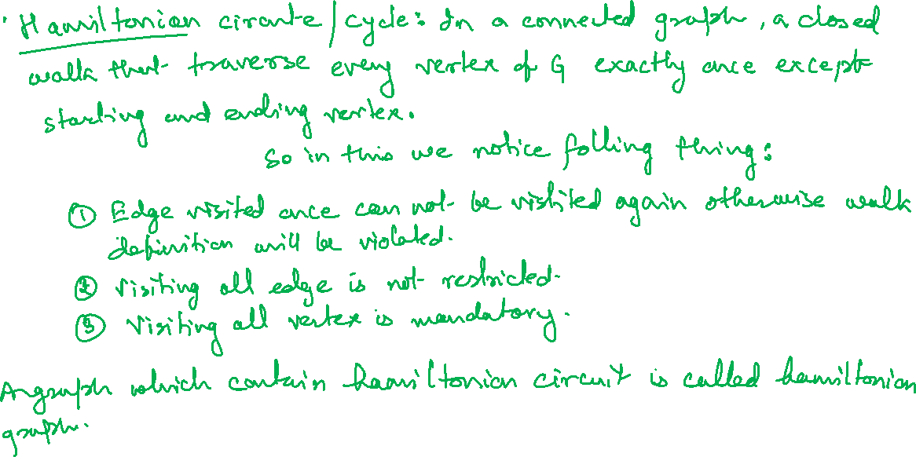

Slide 34
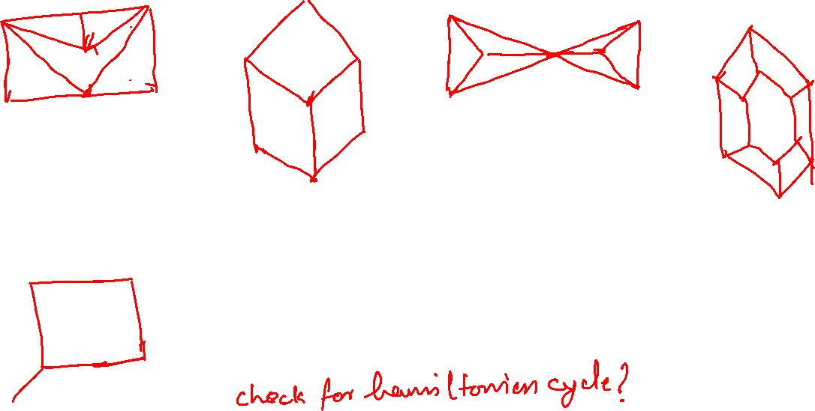

Slide 35
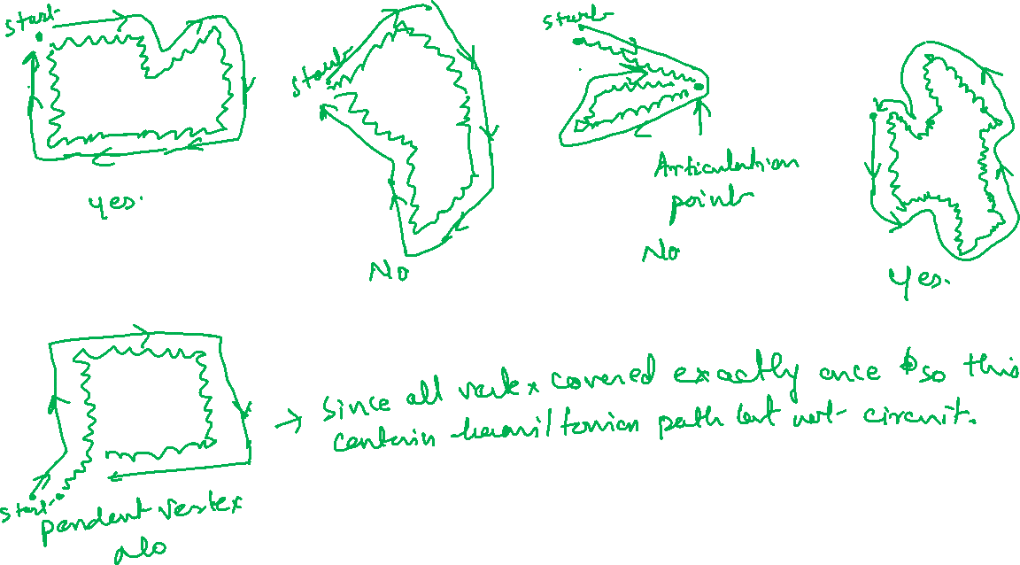

Slide 36
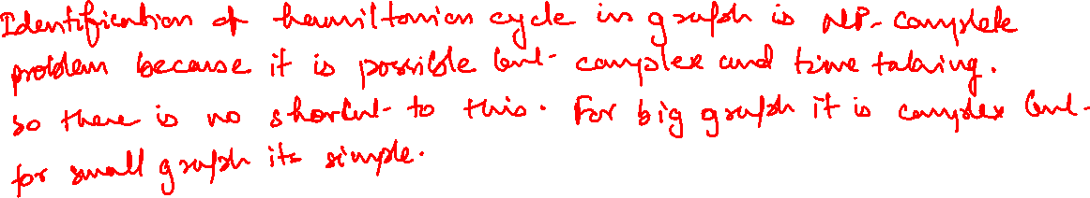
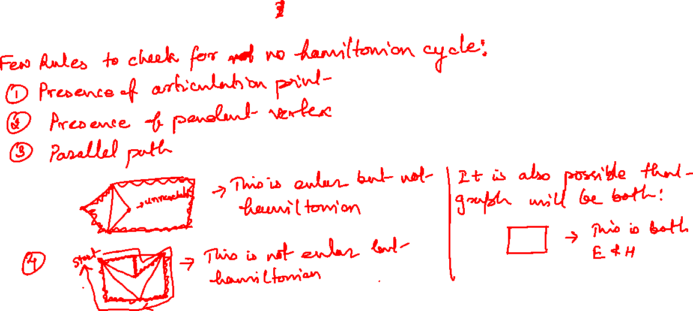

Slide 37
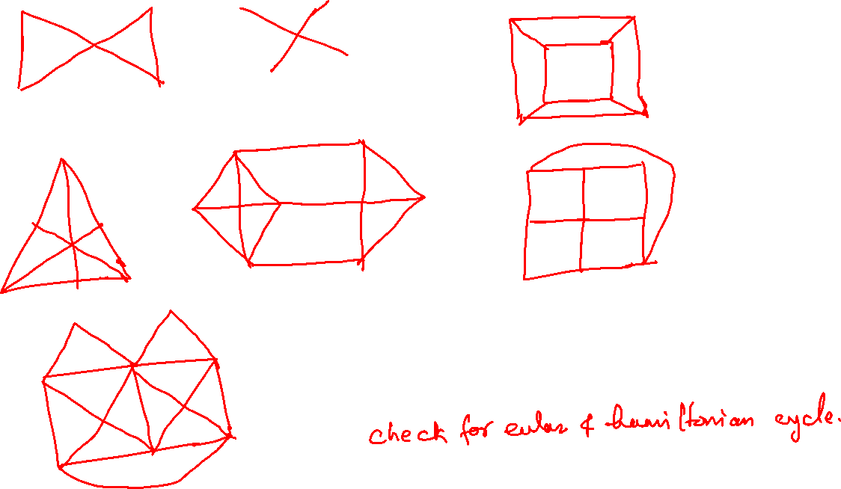

Slide 38
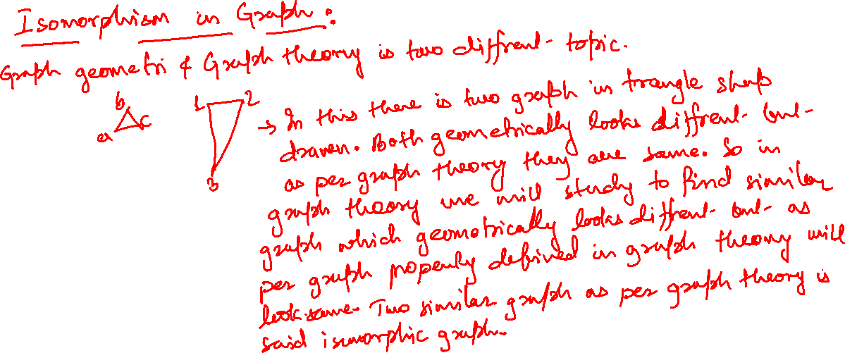

Slide 39
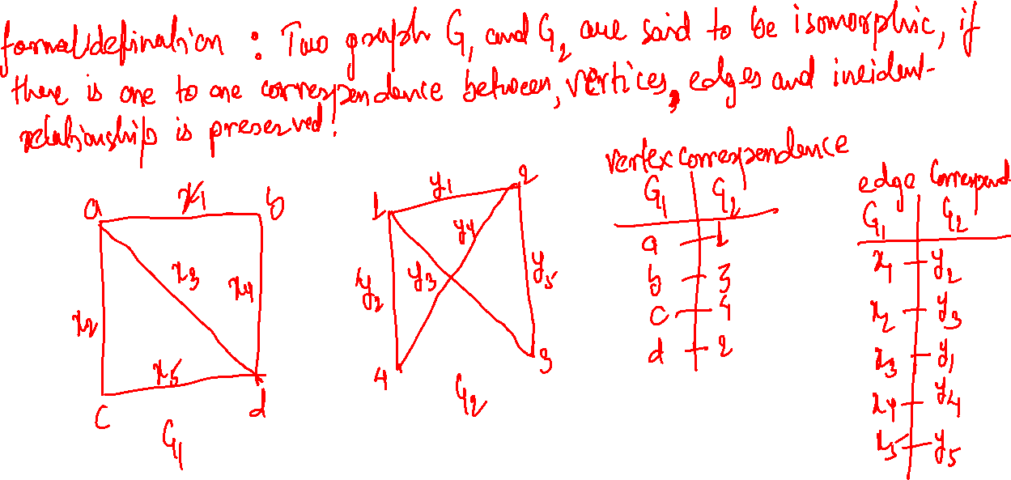

Slide 40
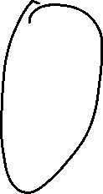

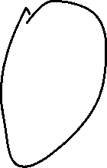

One-to-one functions
A function is one-to-one if each element in the co-domain has a unique pre-image
Meaning no 2 values map to the same result
a
e
i
o
1
2
3
4
5
a
e
i
o
1
2
3
4
5
A one-to-one function
A function that is
not one-to-one

Slide 41
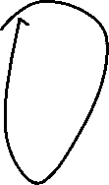

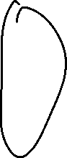

Onto functions
A function is onto if each element in the co-domain is an image of some pre-image
Meaning all elements in the right are mapped to
a
e
i
o
u
1
2
3
4
a
e
i
o
1
2
3
4
5
A function that is not onto
An onto function

Slide 42
Onto vs. one-to-one
Are the following functions onto, one-to-one, both, or neither?
a
b
c
1
2
3
4
a
b
c
d
1
2
3
4
a
b
c
1
2
3
4
1-to-1, not onto
Both 1-to-1 and onto
Not a valid function
a
b
c
d
1
2
3
a
b
c
d
1
2
3
4
Onto, not 1-to-1
Neither 1-to-1 nor onto

Slide 43
Bijections
a
b
c
d
1
2
3
4
Consider a function that is both one-to-one and onto:
Such a function is a one-to-one correspondence, or a bijection

Slide 44
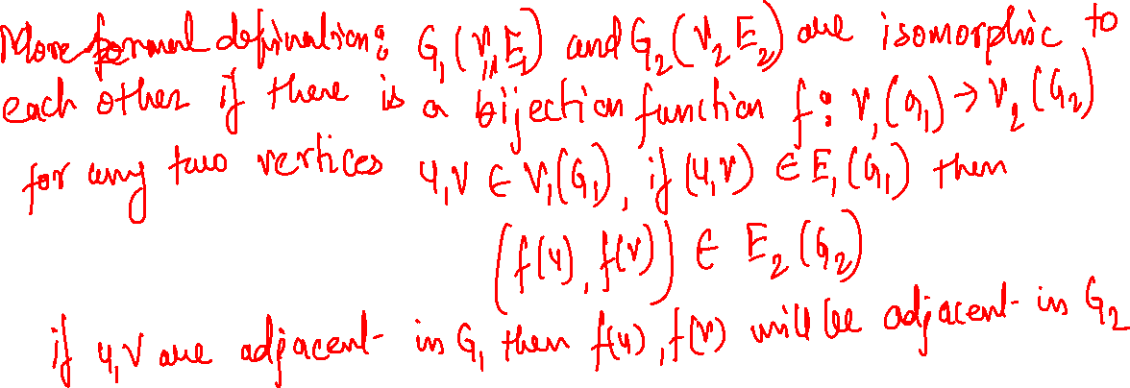
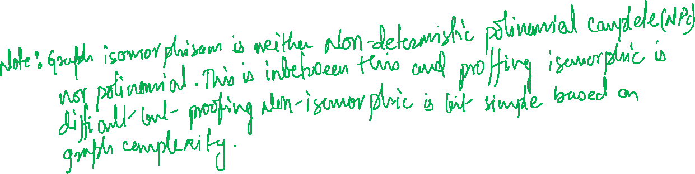

Slide 45
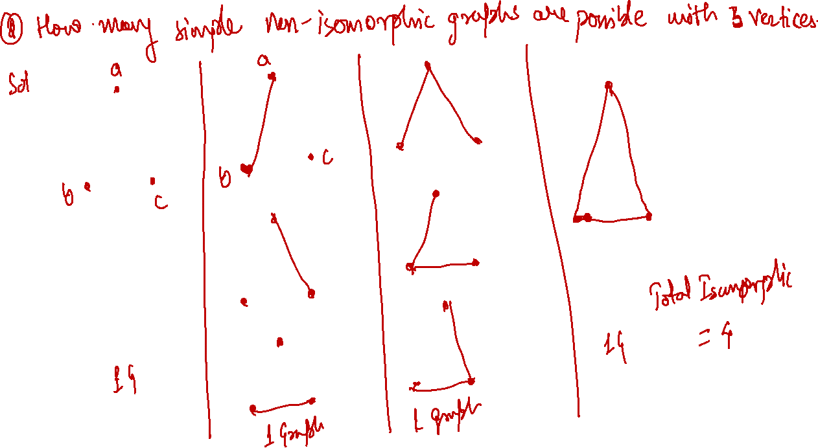

Slide 46
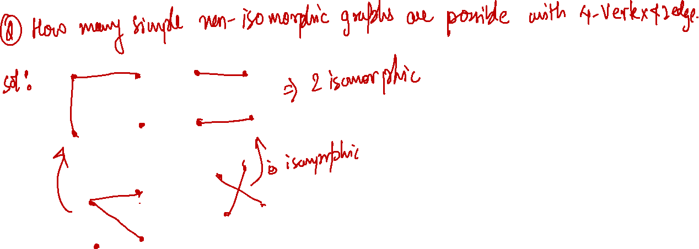

Slide 47
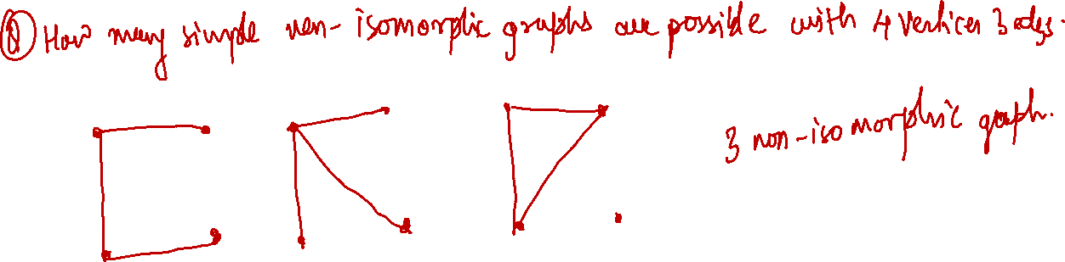

Slide 48
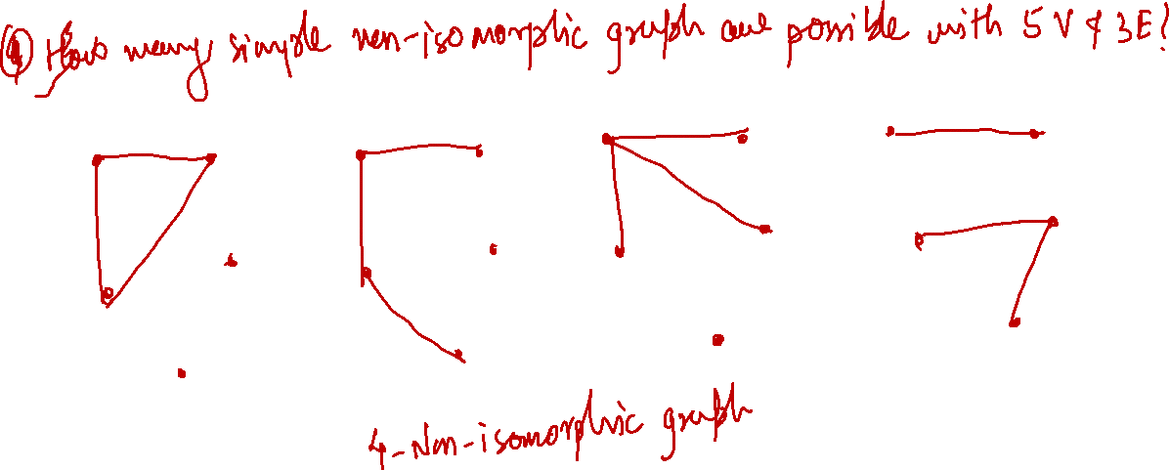

Slide 50
Rules to check Isomorphism
No. of Edges and Vertices
No. of vertices with given degree
Check degree of vertices along with their neighbors
Minimal cycle length, Maximum cycle length,cycle with specific length
Isomorphism for complement of graph
Planer , non-planer
Connected disconnected
Chromatic number
Matching number
Edge connectivity, vertex connectivity

Slide 51


Slide 52


Slide 53


Slide 54


Slide 55


Slide 56



Slide 57



Slide 58


Slide 59


Slide 60


Slide 61


Slide 62


Slide 63


Slide 64



Slide 65


Slide 66


